Slide 1
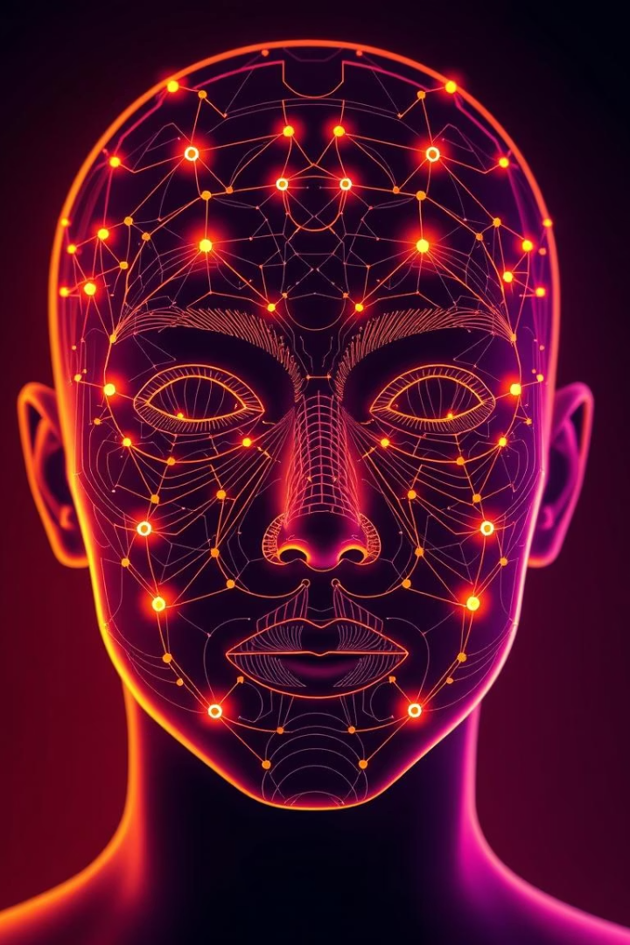

Face ID Authentication System
Using FaceNet and MTCNN for Facial Recognition
by Abdullah Mian

Slide 2
Introduction and Problem Description
Problem Statement:
Traditional authentication methods are susceptible to security breaches
Challenges:
Password management issues
PIN/token theft
Need for more natural, secure authentication
Solution Approach:
Biometric facial recognition using deep learning
Project Goal:
Create a robust face authentication system with minimal hardware requirements

Slide 3
Dataset Description
Data Collection Method:
Real-time webcam capture
Multiple samples per user (5 samples)
Face images stored in organized directories
Data Processing:
Face detection using MTCNN
Storage of facial embeddings rather than raw images
Dynamic user registration system
Data Structure:
Organized dictionary of name-to-embedding mappings
Visual:
Show sample face detection with bounding boxes

Slide 4
Algorithm Description
Face Detection:
MTCNN (Multi-task Cascaded Convolutional Networks)
Efficient facial landmark detection
Bounding box prediction
Feature Extraction:
InceptionResNetV1 pre-trained on VGGFace2
512-dimensional face embeddings
Transfer learning approach
Authentication Process:
Embedding normalization and comparison
Cosine similarity for face matching
Threshold-based authentication (0.6)
Visual:
Flow diagram of the recognition process

Slide 5
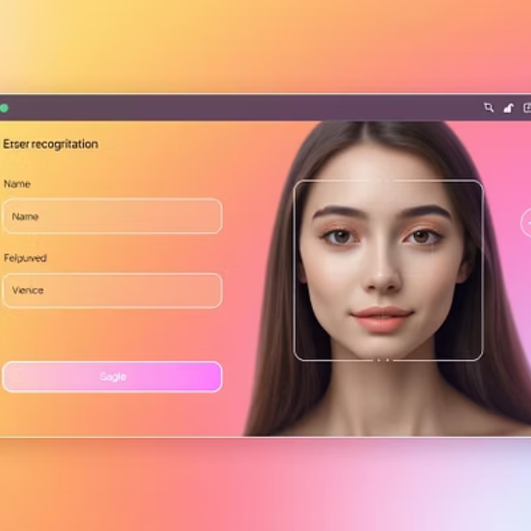
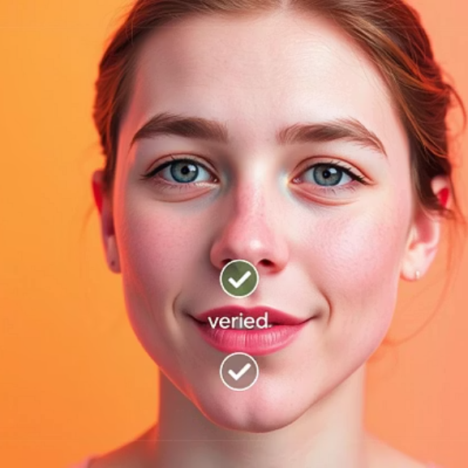

Results System Performance:
Real-time face detection and verification
Multiple user registration capability
Face verification accuracy metrics
Feature Demonstration:
User registration interface
Authentication process
User management system

Slide 6
Analysis
Strengths:
Transfer learning reduces training requirements
Multiple sample registration improves accuracy
Simple interface with minimal setup
Limitations:
Lighting sensitivity
Single-face focus
Fixed threshold may require tuning

Slide 7
Summary and Conclusion
Key Achievements:
Functional face authentication system
User-friendly registration process
Persistent storage of embeddings
Future Improvements:
Multi-face recognition
Anti-spoofing measures
Adaptive thresholding
Conclusion:
Effective demonstration of modern deep learning for biometric authentication
Visual:
Final system architecture diagram

